Slide 1
ECGs for Perfusion
Michael F. Hancock, CCP
Cooper University Hospital
School of Perfusion 2015

Slide 2
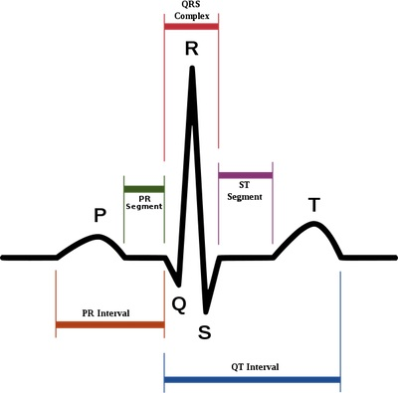
ECG Review
Electrocardiogram (ECG)- detects Electrical Activity in the heart
  Electrical impulses are sent from intrinsic pacemaker sites within the heart
    Electrical Activity does not always equate to Mechanical Activity

Slide 3
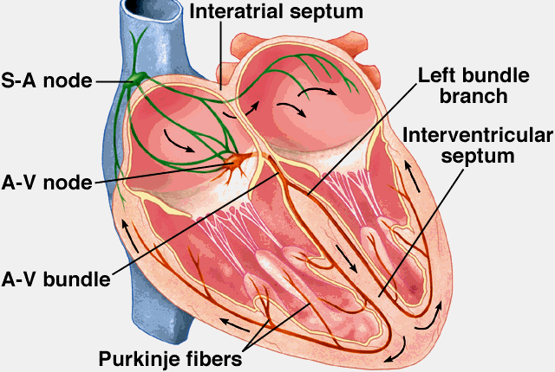
Intrinsic Pacemaker Sites
SA Node- Primary Pacemaker of the Heart
  Rate: 60-100
AV Node-
  Rate: 40-60
Purkinje Fibers-
  Rate: 20-40

Slide 4
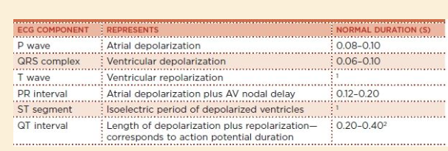
ECG Components
fff

Slide 5
Rhythms in the OR
Normal Sinus
Bradycardia
Tachycardia
Atrial Fibrillation
Atrial Flutter
Ventricular Fibrillation
Asystole
Tall- Peaked T Waves
ST Segment Elevation
Wide QRS
Ventricular Tachycardia
Premature Ventricular Contraction (PVCs)
Heart Block
Bundle Branch Blocks

Slide 6
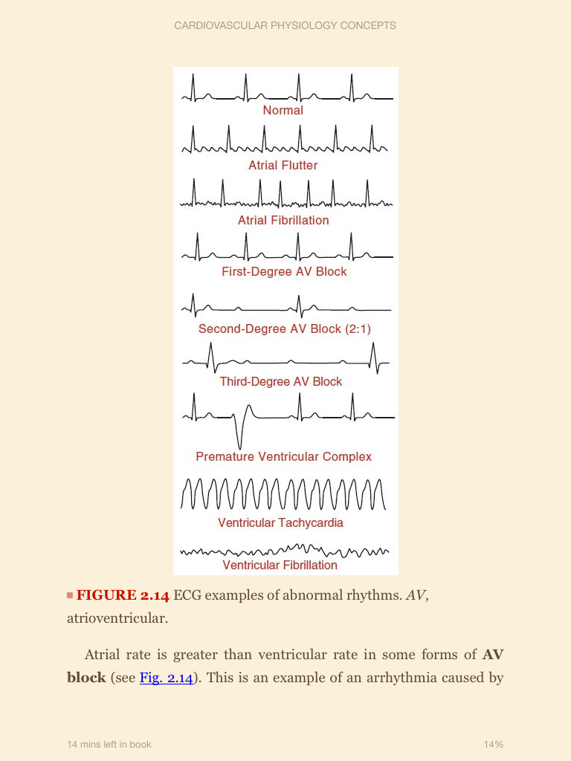
Normal Sinus Rhythm
Rate: 60 – 100
Sinus Bradycardia: Rate < 60
Sinus Tachycardia: Rate > 100

Slide 7
Atrial Flutter
A Flutter: saw tooth appearance
  Atrial rate of 250 – 350
    Not all of those impulses are conducted through the AV Node

Slide 8
Atrial Fibrillation
A Fib: No Discernable P-Waves
  SA Node does not trigger depolarizations
  Depolarizations arise from many sites in the atria
  Uncoordinated, low-voltage, high-frequency depolarizations with no discernable P Waves
Ventricular rate is irregular and usually rapid
  AV Node will limit impulse transmission to limit the ventricular rate
    Important due to high ventricular rates have lower filling times which reduce cardiac output

Slide 9
Atrial Fibrillation
The most common arrhythmia in the world
  Leads to:
    Loss of “Atrial Kick” (~10%)
    Palpitations leading to discomfort of anxiety
    Loss of AV synchrony
      Leading to LV dysfunction and CHF
    Stasis of blood flow in the LA (Clot Formation)
      Increasing the risk of thromboembolism and stroke
      Clot formation is most common in the left atrial appendage
        Left atrial appendage is often ligated during surgical procedures to prevent this
    Leads to other arrhythmias
Two Types:
  Paroxysmal Afib: intermittent or can be stopped
  Permanent: cannot be stopped

Slide 10
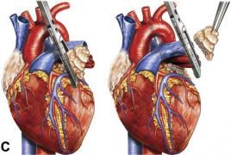
Treating A Fib
Synchronous Cardioversion
  An electric shock delivered once the patient’s R Wave is sensed
    Shocks them back into normal sinus rhythm
Amiodarone:
  Anti-arrhythmic drug aimed at Supra-ventricular dysrhythmias
Warfarin (Coumadin):
  Prevent against clot formation
  Xarelto?? Newer drug
    Inhibits Factor Xa
    Don’t have to monitor INR
Ligation of Left Atrial Appendage
  Use sutures or a device
Atriclip-
  Device used to ligate LAA

Slide 11
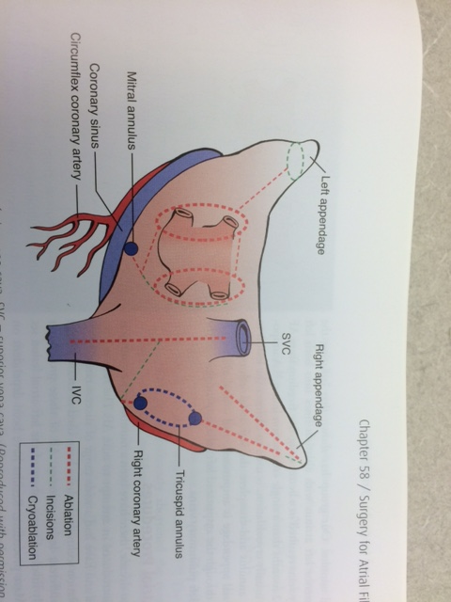
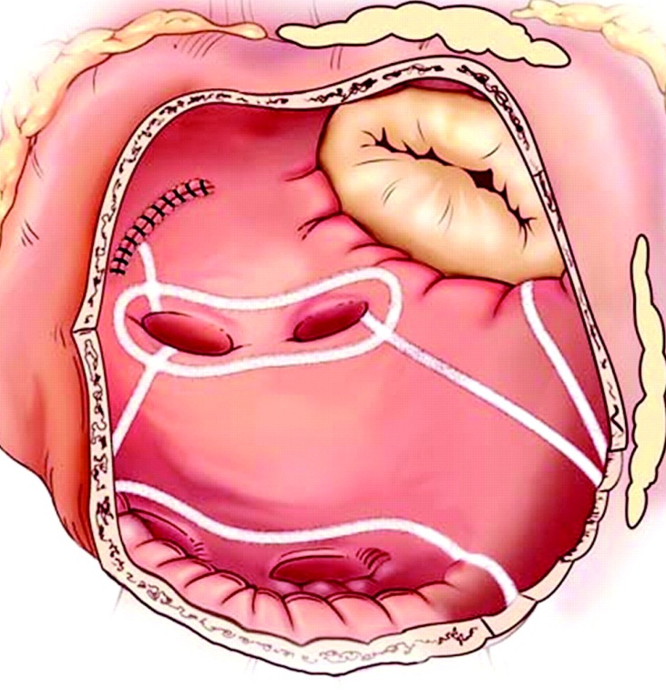
MAZE Procedure
Cox-Maze Procedure (older)- incision made in atria, interrupt re-entry routes (abhorrent pathways)
  Also direct the sinus node impulses to the AV Node
MAZE (newer)-
  Radiofrequency- “burn”
  Cryo- “freeze”
  Ultrasound (High Intensity Focused Ultrasound)- focused energy

Slide 12
Ventricular Tachycardia
Ventricular rate is higher than Atrial Rate (100-200)
  Re-entry arrhythmias caused by abnormal impulse conduction in the ventricles
  Impairs ventricular filling and can lead to Vfib

Slide 13
Ventricular Fibrillation
No discernable QRS Complexes
Cardiac Output goes to Zero
  Rapid, low-voltage, uncoordinated depolarizations
Causes:
  Reperfusion of zones of ischemia
  Infarction

Slide 14
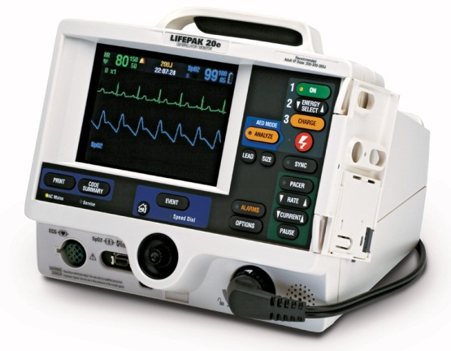
Fixing V Fib
Defibrillate the Patient!
  Delivers an Asynchronous Impulse to Defibrillate the patient
  Meds:
    Lidocaine (not part of ACLS anymore)
    Amiodarone (ACLS guideline)
    Check electrolytes:
      Potassium levels?
      Magnesium?

Slide 15
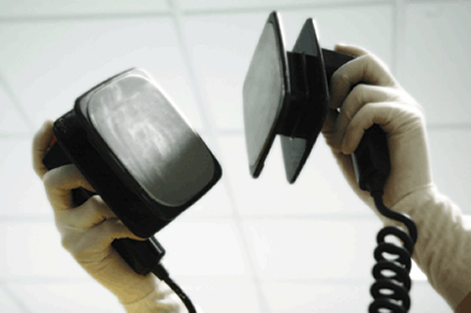
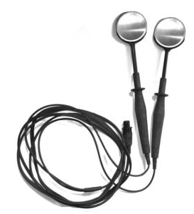
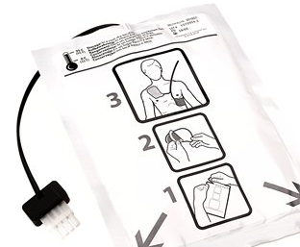
Defibrillating Options
External Paddles: set to ~ 300 joules
Internal Paddles: set to ~ 50 joules
Transcutaneous R2 Pads: set to ~300 joules

Slide 16
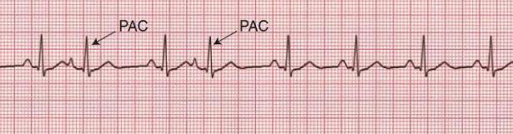
Premature Atrial Contractions (PACs)
Extra and Early P Waves
  From Ectopic Pacemaker sites in the atria
  Irregularly shaped P Wave
  Normal QRS
  Frequent PACs may precede Paroxysmal SVT, A-fib, or A-flutter

Slide 17
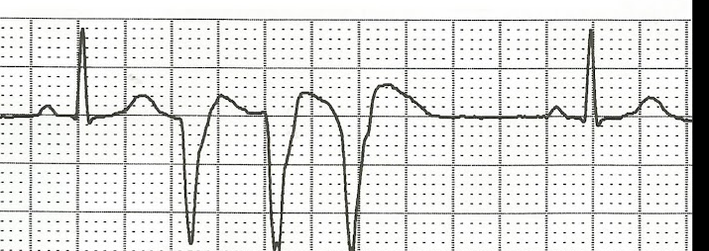
Premature Ventricular Contractions (PVCs)
Extra and Early QRS Complexes
    From Ectopic Pacemaker sites in the ventricles
No P Wave preceding the PVC
Wide QRS in the PVC (>0.12)
Single PVC:
Triplet PVCs:

Slide 18
Heart Block
AV Block
  Depressed impulse transmission from atria to ventricle
  Atrial rate is higher than ventricular rate
First Degree AV Block:
  One P Wave to One QRS
  Long PR Interval ( > 0.2)
Second Degree AV Block:
  Two or three P Waves to One QRS
  Impulse gets through AV Node and generate ventricular depole
Third Degree AV Block:
  No atrial depolarizations are conducted through AV Node
  P Waves and QRS are completely dissociated
  Ventricles still depolarize but due to intrinsic ventricle pacer site
    Rate of <40

Slide 19
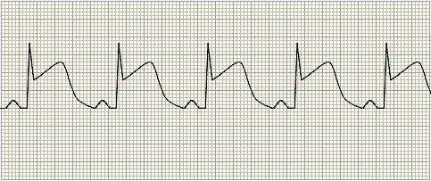
ST Segment Elevation
ST Elevation = Transmural Ischemia or Pericarditis
  Ischemia:
    Due to Coronary Vasospasm, Thrombus, or a tight fixed coronary artery lesion
ST Elevation can be the first ECG manifestation of a Myocardial Infarction
Symptoms will include angina, CP, SOB

Slide 20
ST Elevation Fix
Meds:
  ASA and Nitrates given to resolve possible vasospasm
  Thrombolytics given to relieve possible thrombus
Cath. Lab for PCI
Cardiac Surgery for CABG

